Slide 1

DAY - 01
CLOUD COMPUTING
Module 1: IT & Virtualization Foundations
Instructor: Mohammad Afzal
Course Duration: 30 Hours

Slide 2


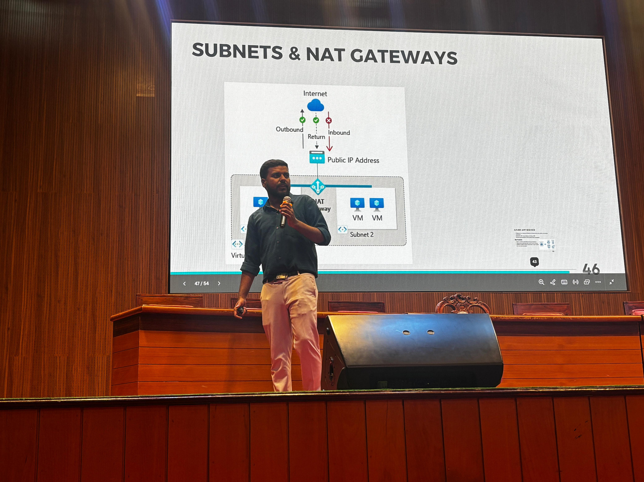
MOHAMMED
AFZAL
Cloud & DevOps Engineer | Multi-Cloud Specialist
Professional Background
Cloud and DevOps engineer with experience in designing and managing cloud infrastructure
Experience working with multi-cloud platforms including Microsoft Azure, AWS, and Google Cloud
Skilled in automation, infrastructure deployment, and cloud security
Technical Expertise
Cloud Platforms: Microsoft Azure, AWS, Google Cloud
DevOps Tools: Docker, Kubernetes, Terraform, Git
Scripting & Automation: PowerShell, Shell scripting, Python
Infrastructure: Virtualization, Networking, Cloud Architecture
Certifications
AWS Solutions Architect – Associate
Microsoft Azure Fundamentals (AZ-900)
Microsoft AI Fundamentals (AI-900)

Slide 3

WHAT WE WILL LEARN TODAY
Hardware vs Software
CPU, RAM and Storage
Operating Systems
Server vs Client
Networking Basics
Virtualization Concepts
Hypervisors
Microsoft Hyper-V
Linux Basics for Cloud

Slide 4
WHY IT FOUNDATIONS MATTER
Even business professionals need basic IT knowledge because:
Most companies run on digital systems
Cloud computing powers modern businesses
Technology decisions affect cost and scalability
Managers must understand IT capabilities

Slide 5
WHAT WE WILL LEARN TODAY
How traditional IT infrastructure works
What servers and data centers are
What virtualization means
Why companies moved to cloud computing
Real business examples

Slide 6
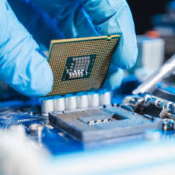
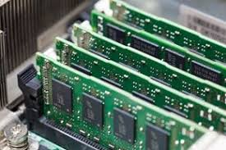
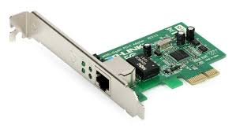
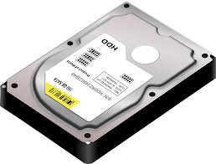
HARDWARE VS SOFTWARE
Hardware are the Physical components of a computer.
Examples:
CPU
Memory
Hard disk
Network cards

Slide 7
HARDWARE VS SOFTWARE
Softwares are Programs that run on hardware.
Examples:
Operating systems
Applications
Databases
Simple idea:
Hardware = Body
Software = Brain

Slide 8
KEY HARDWARE COMPONENTS
Three major components:
CPU (Processor)
Performs calculations and executes instructions
RAM (Memory)
Temporary memory used by running programs
Storage
Long-term storage for data

Slide 9
CPU (CENTRAL PROCESSING UNIT)
The CPU is the brain of the computer.
Functions:
Executes instructions
Processes data
Runs applications
Examples of CPU manufacturers:
Intel
AMD
In cloud environments, CPU is often measured in vCPUs (virtual CPUs).

Slide 10
RAM (MEMORY)
RAM stores data currently used by applications.
Characteristics:
Fast access
Temporary storage
Data lost when power is off
Example:
If you open many browser tabs → RAM usage increases.

Slide 11
STORAGE
Storage keeps data permanently.
Types:
HDD (Hard Disk Drive)
SSD (Solid State Drive)
Examples of stored data:
Documents
Databases
Applications
Operating systems
Cloud providers offer block storage and object storage.

Slide 12
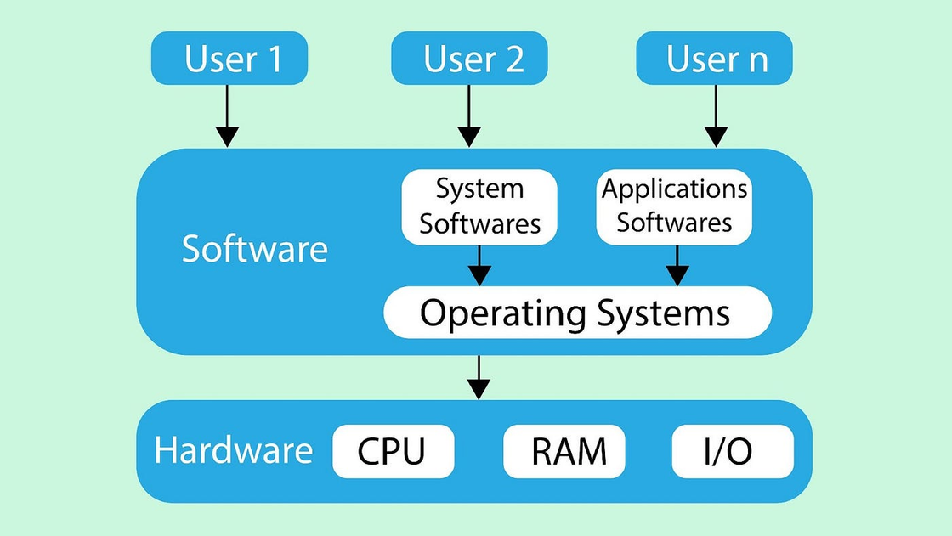
WHAT IS AN OPERATING SYSTEM?
An Operating System (OS) manages computer hardware and software resources.
It acts as an interface between:
Users → Applications → Hardware
Examples:
Windows
Linux
macOS

Slide 13
FUNCTIONS OF AN OPERATING SYSTEM
Key responsibilities:
Managing hardware resources
Running applications
Managing files
Managing memory
Providing security and access control

Slide 14
WINDOWS VS LINUX
Windows
User-friendly interface
Popular in enterprise desktops
Microsoft ecosystem
Linux
Open-source
Highly customizable
Widely used in cloud environments
Most cloud servers run Linux.

Slide 15
WHAT IS A CLIENT?
A client is a device that requests services.
Examples:
Laptop
Mobile phone
Web browser
Example:
When you open a website, your laptop acts as a client.

Slide 16
WHAT IS A SERVER?
A server is a computer that provides services to clients.
Examples:
Web server
Database server
Email server
Servers are designed for:
High performance
Continuous operation
Handling many users simultaneously

Slide 17
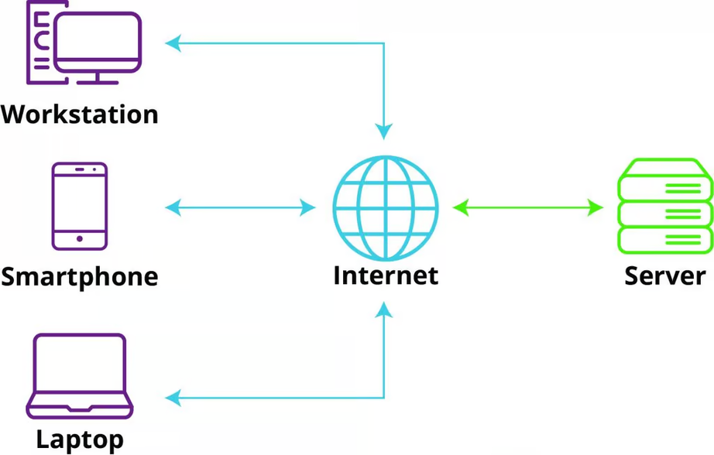
CLIENT–SERVER MODEL
Example:
Client → requests website
Server → sends webpage
Example services:
Gmail
Online banking
E-commerce websites

Slide 18
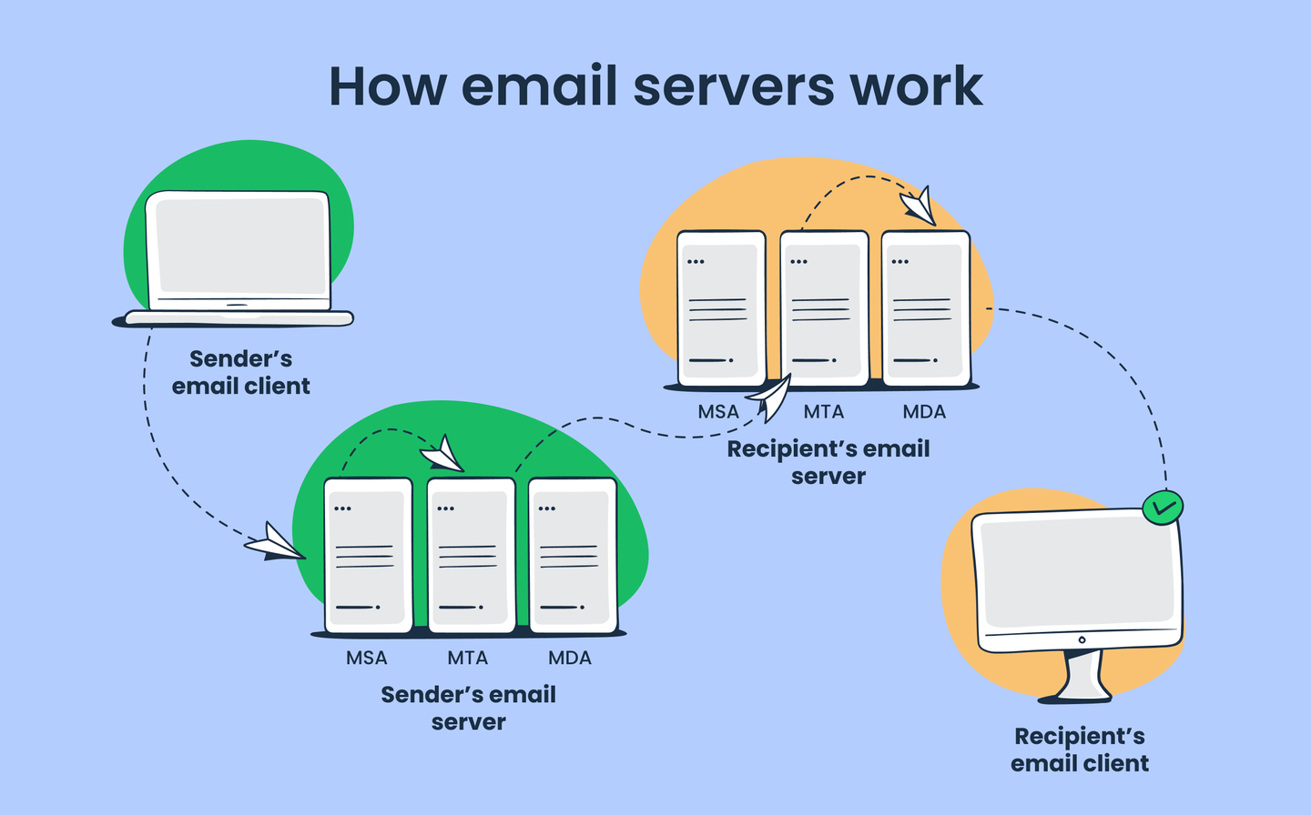
CLIENT–SERVER MODEL
Example:
Client → requests website
Server → sends webpage
Example services:
Gmail
Online banking
E-commerce websites

Slide 19
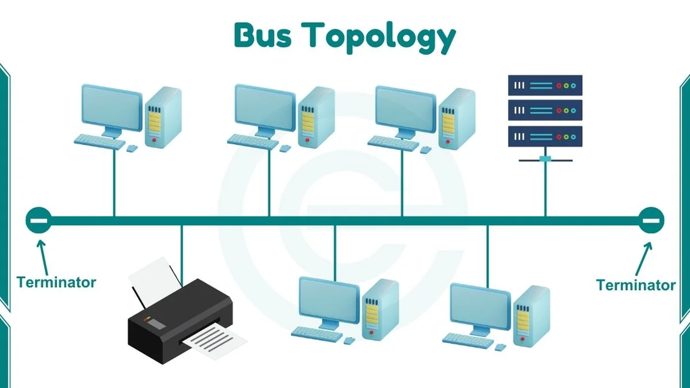
NETWORKING BASICS
Networking connects computers together.
It allows systems to:
Share data
Communicate
Access internet services
Key components:
IP Address
DNS
HTTP / HTTPS

Slide 20
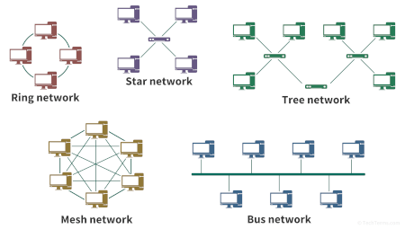
NETWORKING BASICS
Networking connects computers together.
It allows systems to:
Share data
Communicate
Access internet services
Key components:
IP Address
DNS
HTTP / HTTPS

Slide 21
IP ADDRESS
Every device on a network has an IP address.
Example:
192.168.1.1
Purpose:
Identifies devices
Allows communication between systems
Similar to a home address for computers.

Slide 22
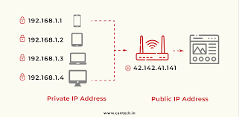
IP ADDRESS
Every device on a network has an IP address.
Example:
192.168.1.1
Purpose:
Identifies devices
Allows communication between systems
Similar to a home address for computers.

Slide 23
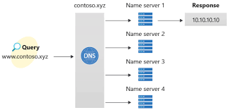
DNS (DOMAIN NAME SYSTEM)
DNS translates domain names into IP addresses.
Example:
google.com
↓
142.250.183.78
This allows users to remember names instead of numbers.

Slide 24
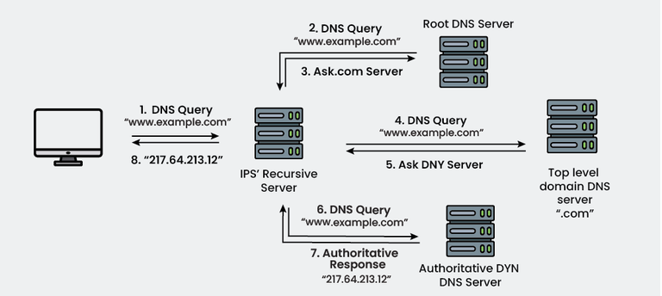
DNS (DOMAIN NAME SYSTEM)
DNS translates domain names into IP addresses.
Example:
google.com
↓
142.250.183.78
This allows users to remember names instead of numbers.

Slide 25
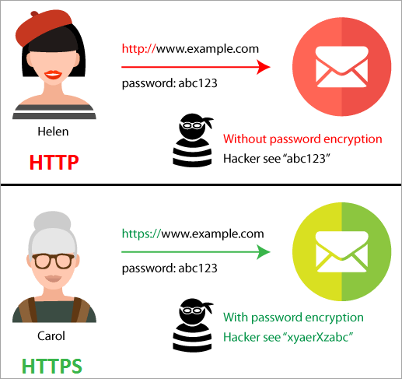
HTTP AND HTTPS
Protocols used to transfer data on the web.
HTTP: Standard web communication.
HTTPS: Secure communication using encryption. Most modern websites use HTTPS.

Slide 26
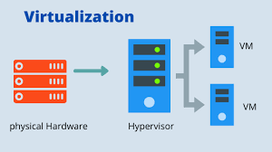
INTRODUCTION TO VIRTUALIZATION
Virtualization allows multiple virtual machines to run on a single physical server.
Instead of:
1 server = 1 application
We can run:
1 server = multiple virtual machnes.

Slide 27
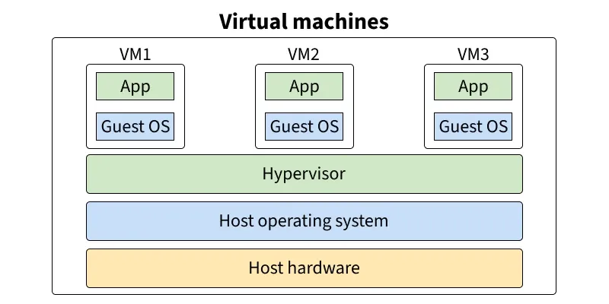
WHAT IS A VIRTUAL MACHINE?
A Virtual Machine (VM) is a software-based computer.
Each VM has:
CPU
RAM
Storage
Operating system
It behaves like an independent machine.

Slide 28
WHY VIRTUALIZATION BECAME POPULAR
Before virtualization: Servers were underutilized.
Example:
10 servers purchased
Only 30–40% used
Virtualization improves resource utilization.

Slide 29
WHAT IS A HYPERVISOR?
A hypervisor is software that creates and manages virtual machines.
It controls:
CPU allocation
Memory allocation
Storage
Networking
Examples:
VMware
Microsoft Hyper-V
KVM

Slide 30
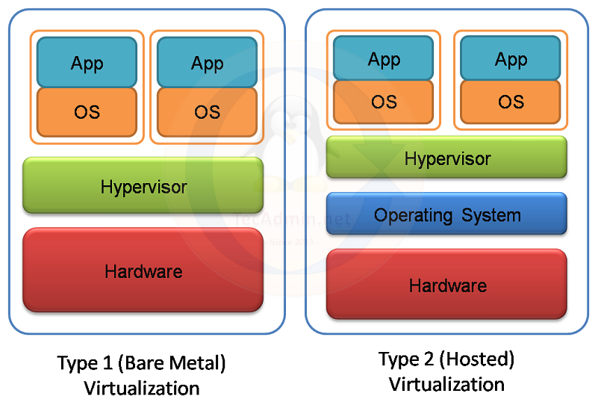
HYPERVISOR TYPES
Two main types:
Type 1 – Bare Metal - Runs directly on hardware. - Used in data centers.
Examples:
VMware ESXi
Microsoft Hyper-V

Slide 31
HYPERVISOR TYPES
Two main types:
Type 2 – Runs on top of an operating system.
Examples:
VirtualBox
VMware Workstation
Used for:
Testing
Development
Learning environments

Slide 32
BENEFITS OF VIRTUALIZATION IN ENTERPRISES
Organizations gain:
Better hardware utilization
Reduced infrastructure costs
Faster deployment
Easier disaster recovery
Improved scalability

Slide 33

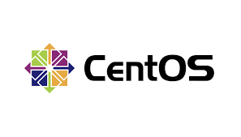


LINUX FUNDAMENTALS FOR CLOUD
Linux is the most widely used operating system in cloud environments.
Examples:
Ubuntu
CentOS
Red Hat Enterprise Linux
Reasons for popularity:
Stability
Security
Open-source
Automation support

Slide 34
WHY CLOUD PLATFORMS PREFER LINUX
Most cloud workloads run Linux because:
Lightweight
Efficient resource usage
Strong networking capabilities
Easy automation using scripts

Slide 35
SUMMARY
Today we covered:
Hardware vs software
CPU, RAM, storage
Operating systems
Server vs client architecture
Networking fundamentals
Virtualization and hypervisors
Microsoft Hyper-V
Linux basics for cloud computing

Slide 36


THANK YOU
SEE YOU TOMMOROW
+91 9988007766
www.reallygreatsite.com

Slide 37
DAY - 02
CLOUD COMPUTING
Module 2: Cloud Computing Fundamentals
Instructor: Mohammad Afzal
Course Duration: 30 Hours

Slide 38
SUMMARY
Today we covered:
What is Cloud Computing
Evolution of IT Infrastructure
Cloud Service Models
Cloud Deployment Models
Cloud Regions and Availability Zones
Scalability and High Availability
CapEx vs OpEx
Cloud Business Use Cases

Slide 39
WHAT IS CLOUD COMPUTING?
Cloud computing is the delivery of computing services over the internet.
These services include:
Servers
Storage
Databases
Networking
Software applications
Organizations rent resources instead of owning infrastructure.

Slide 40
SIMPLE CLOUD DEFINITION
Cloud computing means:
Accessing computing resources on demand through the internet and paying only for what you use.
Examples:
Google Drive
Microsoft 365
Netflix infrastructure
AWS and Azure services

Slide 41




EVERYDAY CLOUD EXAMPLES
Common services using cloud:
Gmail
Dropbox
Zoom
Spotify
Netflix
Users access services without knowing where the servers are located.

Slide 42
EVOLUTION OF IT INFRASTRUCTURE
IT infrastructure evolved in three major stages:
Traditional On-Premises Infrastructure
Virtualization
Cloud Computing
Each stage improved efficiency and scalability.

Slide 43
STAGE 1: ON-PREMISES INFRASTRUCTURE
Companies hosted systems in their own data centers.
Requirements:
Buy servers
Install networking
Maintain hardware
Manage upgrades
Hire IT staff
Challenges:
High cost
Limited scalability
Long setup time

Slide 44
STAGE 2: VIRTUALIZATION
Virtualization improved efficiency by allowing:
Multiple virtual machines on one server
Better resource utilization
Faster provisioning
However, companies still needed:
Data centers
Hardware maintenance
Infrastructure management

Slide 45
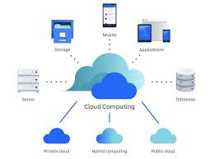
STAGE 3: CLOUD COMPUTING
Cloud providers manage infrastructure.
Organizations simply use the services they need.
Benefits:
No hardware purchase
Instant scalability
Global availability
Pay-as-you-go pricing

Slide 46


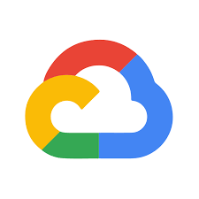
MAJOR CLOUD PROVIDERS
Leading global cloud providers include:
Amazon Web Services (AWS)
Microsoft Azure
Google Cloud Platform (GCP)
These companies operate large global data centers.

Slide 47
CLOUD SERVICE MODELS
Cloud services are delivered in three main models:
IaaS — Infrastructure as a Service
PaaS — Platform as a Service
SaaS — Software as a Service
Each model provides different levels of control and management.

Slide 48
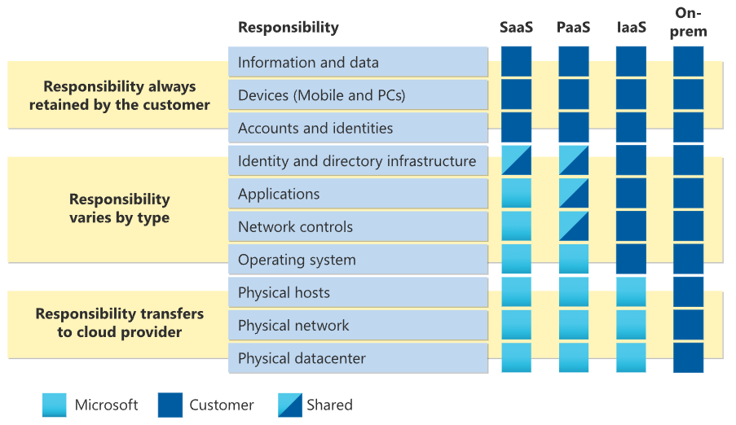
CLOUD RESPONSIBILITY MODEL

Slide 49
CLOUD DEPLOYMENT MODELS
Organizations can deploy cloud in different ways:
Public Cloud
Private Cloud
Hybrid Cloud
Each model serves different business needs.

Slide 50
PUBLIC CLOUD
Infrastructure owned by cloud providers and Resources shared among multiple customers.
Examples:
AWS
Microsoft Azure
Google Cloud
Advantages:
Low cost
High scalability
Global availability

Slide 51
PRIVATE CLOUD
Infrastructure dedicated to a single organization.
Characteristics:
Higher control
Enhanced security
Custom configurations
Used by:
Government agencies
Financial institutions

Slide 52
HYBRID CLOUD
Hybrid cloud combines:
On-premises infrastructure
Public cloud services
Benefits:
Flexibility
Data control
Scalability
Many enterprises use hybrid architectures.

Slide 53
AVAILABILITY ZONES
Each region contains multiple availability zones.
Availability zones are:
Physically separate data centers
Connected with high-speed networks
Purpose:
Improve reliability and fault tolerance.

Slide 54
BENEFITS OF PUBLIC CLOUD
High Availability
Scalability
Elasticity
Flexibilty
Capital Expenditure (CapEx)
Operational Expenditure (OpEx)

Slide 55
CLOUD BUSINESS USE CASES
Cloud enables many business scenarios:
E-commerce platforms
Data analytics
Global applications
Disaster recovery
Mobile applications
Examples of companies using cloud:
Netflix — streaming infrastructure
Airbnb — global platform scalability
Uber — real-time data processing
Cloud enables rapid innovation.

Slide 56
DAY 2 SUMMARY
Today we learned:
What cloud computing is
Evolution of IT infrastructure
Cloud service models
Deployment models
Regions and availability zones
Scalability and elasticity
CapEx vs OpEx

Slide 57
THANK YOU
SEE YOU TOMMOROW
+91 9988007766
www.reallygreatsite.com

Slide 58
BIG DATA ANALYTICS
Module 1: Introduction to Big Data Analytics
Instructor: Mohammad Afzal

Slide 59
WHAT WE WILL LEARN TODAY
Types of data
What Big Data is
Characteristics of Big Data (5Vs)
Evolution of data systems
Difference between BI and Big Data
Big Data ecosystem
Business applications in HR, Marketing, Finance

Slide 60
WHAT IS DATA?
Data is raw facts and figures that can be processed to generate information.
Examples:
Numbers (sales data)
Text (customer feedback)
Images (product photos)
Videos (surveillance footage)

Slide 61
TYPES OF DATA
Data can be classified into three types:
Structured Data
Semi-Structured Data
Unstructured Data

Slide 62
STRUCTURED DATA
Organized in rows and columns
Stored in databases (RDBMS)
Examples:
Excel sheets
Banking transactions
Employee records

Slide 63
SEMI-STRUCTURED DATA
Not strictly organized but has some structure
Uses tags or key-value pairs
Examples:
JSON files
XML files
Emails

Slide 64
UNSTRUCTURED DATA
No predefined format
Difficult to store in traditional databases
Examples:
Social media posts
Videos and images
Audio files

Slide 65
WHAT IS BIG DATA?
Big Data refers to extremely large and complex datasets that cannot be processed using traditional systems.
It requires specialized tools and technologies.

Slide 66
WHY BIG DATA IS IMPORTANT
Organizations use Big Data to:
Improve decision making
Understand customer behavior
Increase efficiency
Predict future trends
Gain competitive advantage

Slide 67
CHARACTERISTICS OF BIG DATA (5VS)
Big Data is defined by:
Volume
Velocity
Variety
Veracity
Value

Slide 68
VOLUME
Refers to the amount of data
Example:
Social media generates billions of posts daily

Slide 69
VELOCITY
Speed at which data is generated and processed
Example:
Real-time stock market data

Slide 70
VARIETY
Different types of data
Example:
Text, images, videos, logs

Slide 71
VERACITY
Accuracy and reliability of data.
Example:
Fake reviews vs genuine customer feedback

Slide 72
VALUE
Information
Example:

Slide 73
EVOLUTION OF DATA SYSTEMS
Data processing evolved as:
Traditional Databases (RDBMS)
Data Warehousing
Big Data Systems

Slide 74
TRADITIONAL DATA SYSTEMS
Used structured data
Limited scalability
Worked well for small datasets
Examples:
Banking systems
ERP systems

Slide 75
DATA WAREHOUSING
Data Warehousing is a system used to store large amounts of structured data for analysis and reporting.
Key idea:
It collects data from multiple sources and stores it in a central repository.

Slide 76
FEATURES OF DATA WAREHOUSE
Stores historical data
Structured and organized format
Optimized for analysis and reporting
Supports decision-making

Slide 77
EXAMPLE OF DATA WAREHOUSE
A retail company collects data from:
Sales systems
Customer databases
Inventory systems
All this data is stored in a data warehouse for generating reports.

Slide 78
LIMITATIONS OF DATA WAREHOUSING
Handles mainly structured data
Not suitable for unstructured data (videos, social media)
Expensive to scale
Slower with very large datasets

Slide 79
BIG DATA SYSTEMS
Handle large-scale data
Support structured and unstructured data
Use distributed processing
Examples:
Hadoop
Spark

Slide 80
WHAT IS BIG DATA ECOSYSTEM?
Big Data ecosystem includes tools and technologies used for:
Data storage
Data processing
Data analysis

Slide 81
COMPONENTS OF BIG DATA ECOSYSTEM
Data Sources (applications, sensors, social media)
Storage (HDFS, Cloud storage)
Processing (Hadoop, Spark)
Analytics (BI tools, dashboards)

Slide 82
MODERN DATA ARCHITECTURE
Two key concepts:
Data Warehouse
Data Lake

Slide 83
DATA WAREHOUSE
Stores structured data
Used for reporting and analysis
Organized and cleaned data
Example:
Sales reports

Slide 84
DATA LAKE
Stores raw data (structured + unstructured)
Flexible and scalable
Used for advanced analytics

Slide 85
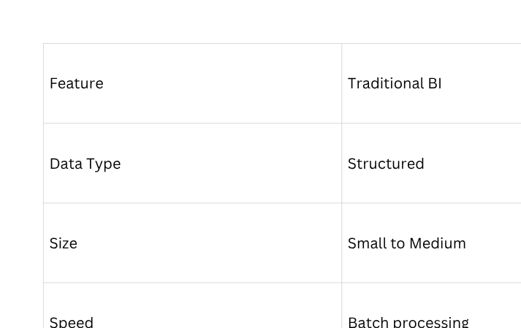
TRADITIONAL BI VS BIG DATA

Slide 86
BUSINESS APPLICATIONS OF BIG DATA
Big Data is used across industries:
HR
Marketing
Finance
Healthcare
Retail

Slide 87
BIG DATA IN HR
Used for:
Employee performance analysis
Attrition prediction
Talent acquisition

Slide 88
BIG DATA IN MARKETING
Used for:
Customer segmentation
Personalized recommendations
Campaign analysis
Example:
Netflix recommendations

Slide 89
BIG DATA IN FINANCE
Used for:
Fraud detection
Risk management
Credit scoring
Example:
Detecting unusual transactions

Slide 90
REAL-WORLD EXAMPLE

Slide 91
SUMMARY
Today we learned:
Types of data
Big Data definition
5Vs of Big Data
Evolution of data systems
BI vs Big Data
Big Data ecosystem
Business applications

Slide 92
DATA LAKE
Stores raw data (structured + unstructured)
Flexible and scalable
Used for advanced analytics

Slide 93
HADOOP ECOSYSTEM
Module 1: Hadoop Ecosystem & MapReduce
Instructor: Mohammad Afzal

Slide 94
LEARNING OBJECTIVES
By the end of this unit, you will understand:
Limitations of traditional databases
Why Hadoop was introduced
Hadoop ecosystem components
HDFS architecture
YARN resource management
MapReduce processing model

Slide 95
RDBMS (TRADITIONAL DATABASES)
RDBMS stands for Relational Database Management System
Examples:
MySQL
Oracle
SQL Server
Used for:
Structured data
Transactions
Business applications

Slide 96
LIMITATIONS OF RDBMS
RDBMS struggles with Big Data because:
Cannot handle very large datasets efficiently
Limited scalability
Expensive hardware scaling
Cannot process unstructured data

Slide 97
NEED FOR HADOOP
To overcome RDBMS limitations, Hadoop was introduced.
Hadoop provides:
Distributed storage
Distributed processing
Scalability using multiple machines
Ability to handle all types of data

Slide 98
WHAT IS HADOOP
Hadoop is an open-source framework used to store and process large datasets across distributed systems.
Key idea:
Instead of using one powerful machine, Hadoop uses multiple machines working together.

Slide 99
KEY FEATURES OF HADOOP
Distributed storage
Fault tolerance
Scalability
Cost-effective
Handles structured and unstructured data

Slide 100
HADOOP ECOSYSTEM
Hadoop ecosystem includes tools for:
Storage → HDFS
Resource Management → YARN
Processing → MapReduce
Querying → Hive
Data processing → Pig

Slide 101
HADOOP ARCHITECTURE OVERVIEW
Hadoop has three core components:
HDFS (Storage)
YARN (Resource Manager)
MapReduce (Processing Engine)

Slide 102
WHAT IS HDFS?
HDFS (Hadoop Distributed File System) is used to store large data across multiple machines.
Key idea:
Data is split into blocks and stored across different nodes.

Slide 103
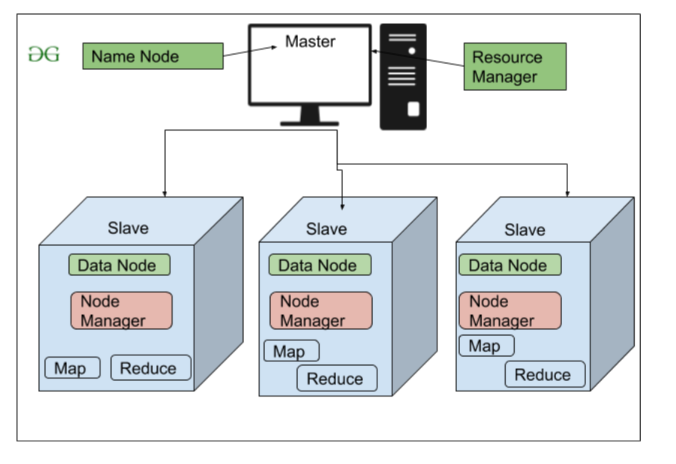
HDFS ARCHITECTURE
HDFS consists of:
NameNode
Manages metadata
Tracks file locations
DataNode
Stores actual data

Slide 104
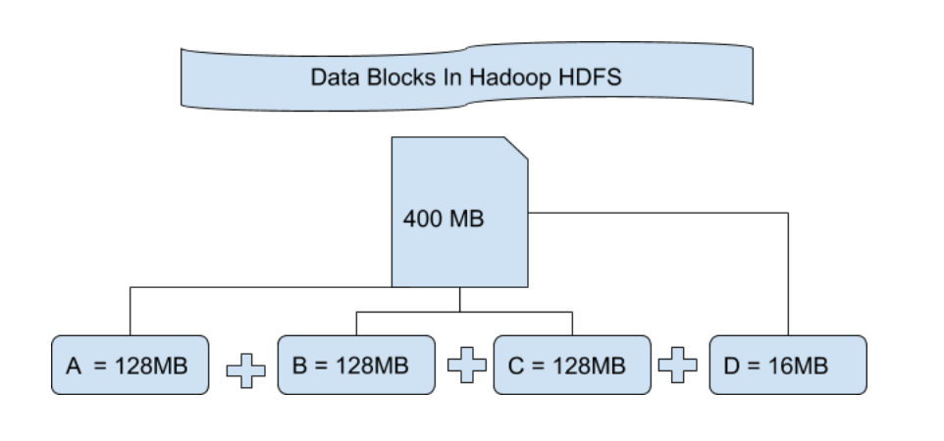
HDFS ARCHITECTURE

Slide 105
HDFS WORKING
Process:
File is divided into blocks
Blocks are stored across multiple DataNodes
Data is replicated for fault tolerance
Fault Tolerance in HDFS
Replicating data across multiple nodes
If one node fails → data is still available

Slide 106
WHAT IS YARN?
YARN (Yet Another Resource Negotiator) manages cluster resources.
Functions:
Allocates CPU and memory
Manages job execution
Schedule tasks

Slide 107
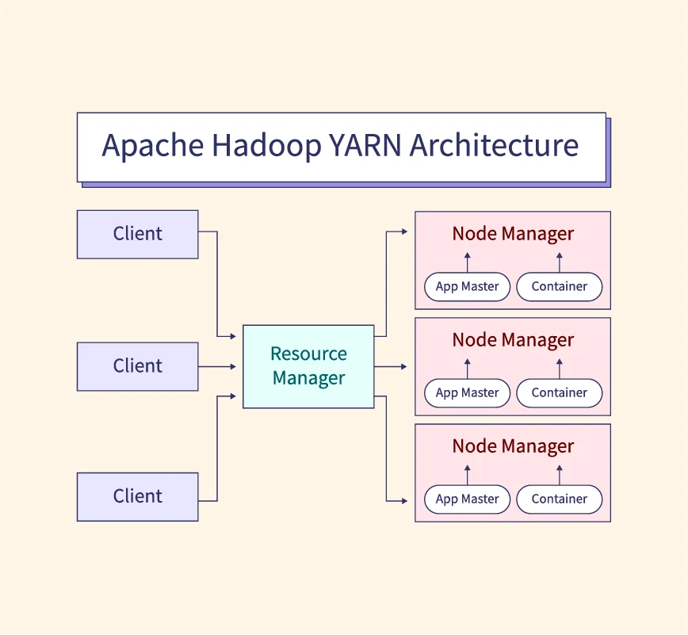
YARN COMPONENTS
Resource Manager
Node Manager
Application Master

Slide 108
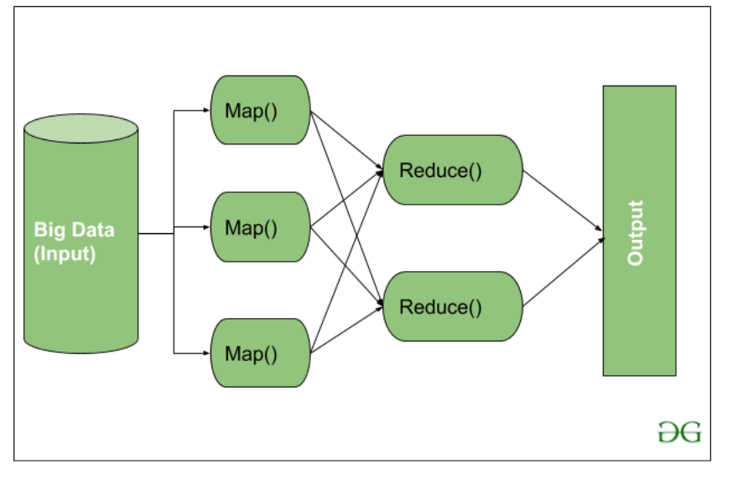
WHAT IS MAPREDUCE?
MapReduce is a programming model used to process large datasets in parallel.
It works in two main phases:
Map
Reduce

Slide 109
MAP PHASE
Input data is divided into smaller parts
Each part is processed independently
Example:
Word count problem → Each mapper counts words in a portion of data

Slide 110
SHUFFLE PHASE
Intermediate data is grouped
Similar data is brought together
Example: All “apple” words grouped together

Slide 111
REDUCE PHASE
Aggregates results from Map phase
Example:
Total count of each word
MapReduce Flow Summary
Input Data
Map
Shuffle & Sort
Reduce
Output

Slide 112
REAL-LIFE ANALOGY
MapReduce is like:
Manager divides work among employees (Map)
Employees complete tasks
Results are combined (Reduce)

Slide 113
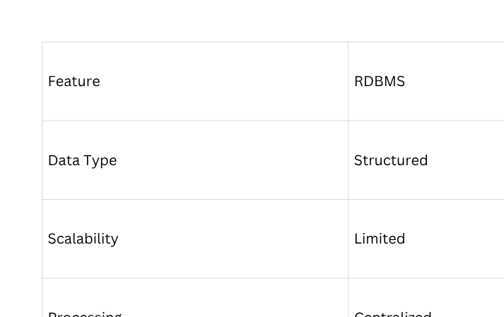
HADOOP VS RDBM

Slide 114
ADVANTAGES OF HADOOP
Complex to manage
Not suitable for real-time processing
Requires technical expertise
Limitations of Hadoop
Complex to manage
Not suitable for real-time processing
Requires technical expertise

Slide 115
WHERE HADOOP IS USED
Social media analytics
Fraud detection
Recommendation systems
Log analysis

Slide 116
SUMMARY
RDBMS limitations
Need for Hadoop
Hadoop ecosystem
HDFS architecture
YARN
MapReduce processing

